Slide 1
Challenges & opportunities of evaluating online programs
The experience of ReachOut.com an online mental health promotion program
Atari Metcalf | Evaluation Manager - Inspire Foundation
Notes:
Introduce self. Role. Newish to evaluation.

Slide 2

Purpose
Explore key challenges and opportunities of evaluating open-access online programs
Review key characteristics of open-access online programs
Discuss the implications of these characteristics and for evaluation design and practice
Explore methodological limitations and future opportunities
Notes:
Implications - will particularly focus on challenges in relation to measuring reach and impact

Slide 3
Outline
Background – overview of ReachOut.com
Reflect on the development and implementation of the ReachOut.com evaluation framework
Case studies: Google Analytics and Annual Survey
Key limitations, challenges and opportunities
Future directions and recommendations
Notes:
The way I plan to address these points is primarily through reflecting on the experience of developing and implementing ReachOut’com’s framework.
Acknowledge my colleagues – especially Kitty Rahilly and Justine Stephens-Reicher in the R&P team.

Slide 4


Background
About ReachOut.com and what makes ICT unique
Notes:
And arguably different from conventional approaches

Slide 5
The context
1 in 4 Australians aged 14-25 experience a mental health problem
71% of whom don’t access help
Suicide is the leading cause of death amongst young people
Suicide and mental ill health are complex and multidimensional in etiology, but both are preventable
Several key determinants and factors known to influence mental health and wellbeing:
  Social connection and belonging
  Resiliency and coping skills
  Stigma, mental heath literacy and early help-seeking
Notes:
Established in response to Australia’s then escalating suicide rates.
Will expand on the aims and objectives when presenting the evaluation framework.

Slide 6
Why Information Communication Technology?
Young people are fastest adopters of ICT– 95% 14-25 year olds online (Ewing 2009)
The internet ranks as this group’s preferred source of help after family and friends (Mission Australia 2009)
Emerging evidence that ICT based interventions can positively change knowledge and behaviour
Key advantages and characteristics of open-access online programs:
Cost-efficient, scalable, interactive, anonymous, available 24/7 and can tailor delivery to suit individual needs
Notes:
RCTs tells us clinical structured programs work – yet to know much about open-access programs like RO due to limited published evals!
It works and is a preferred medium for the target group. Most evidence is RCT based though, so our program is yet to be as rigorously evaluated….in part because an RCT is not quite so appropriate, as we’ll discuss further shortly.
Web-based technology is a relatively new approach being applied for earlier and better management of mental health problems. A number of factors over the last decade, including the development of new and highly interactive web-based technologies and their widespread use in Australia particularly by young people, has seen a growth in number and range of online youth mental health services.. Web-based mental health services offer the potential to overcome some of the common challenges of geographical, attitudinal and financial barriers experienced in traditional face-to-face service delivery (Hickie and Christensen, 2010).
Young people are often resistant to seeking help for mental health difficulties. This resistance has been shown to relate to concerns regarding confidentiality; the belief that their problems
are too personal and they are able to manage them on their own (Burns J et al, 2009).
The advent of Web 2.0 technology and the uptake of broadband connections to the internet rapidly created a greater range of ways for an individual to interact, collaborate and contribute online. Its enhanced features has blurred the boundaries between consumer and producer. Applications like blogs, networking websites, podcasts and vodcasts allow individuals to create and publish their own online content. The functionality of Web
2.0 technology helps young people to feel more empowered online and better able to explore sensitive and often stigmatised issues (Burns J. et al, 2010).

Slide 7
ReachOut.com – an open-access online mental health promotion program
Established in 1997
Aims to prevent the development of mental health problems amongst young people aged 14-25 and contribute to reduced suicide by
  Increasing social connection and belonging
  Increasing mental health literacy and reducing stigma
  Increasing help-seeking*
Achieved through a comprehensive mix of universal, selective and early-intervention strategies
Open-access and unstructured program → users tailor their own experience
Notes:
Inherent in this is – multiple target segments! With and without illness…
Established in response to Australia’s then escalating suicide rates.
RO leverages those unique characteristics. Especially scale and tailored experience. Average over 96,000 unique visitors per month. 1.3 million per year!
The aim of the program is to provide a space where young people can safely and anonymously access information and share personal experiences about mental health issues
in different ways. The service is delivered using internet and mobile phone technologies which are young people’s preferred medium of communication and help-seeking. It offers
different protective factors that have been shown to positively impact on the mental health and well-being including positive participation, resilience, life skills and social connectedness.
It aims to reduce stigma that young people experience about mental health difficulties and to promote better emotional, mental and social health and well-being.
The ReachOut approach focuses on health promotion, prevention and early intervention. It uses a population health approach where the size of the population reached is key to the
success of the program that intentionally targets a large scale and diverse group of young people aged 14 – 25 years.
Draws on a range of different conceptual models and behavioural change theories, including the theory of planned action, transtheoretical model and health belief model.

Slide 8
Key program components
← Youth participation →
1 Facts + stories | 2 Online Community | 3 Social marketing | 4 Teachers + professionals | 6 Interactive CBT game
Targeted, audience focused, evidence based content disseminated across our platforms and syndicated through media and our partners. Increased focus on media – rich and portable formats | Online peer to peer support to build social connections and reduce feelings of isolation. Online forums, and outreach via social networking sites - Habbo Hotel. | Awareness campaigns and social marketing initiatives that span online, social media, traditional media and place-based strategies. | Sister websites containing resources for teachers and professionals who work with young people in health and community settings | ReachOut central uses principles of CBT to explore how thoughts and behaviour can affect feelings; and to develop social skills
Notes:
ReachOut is a multi-level, multi-component mental health strategy. It connects young people to information, appropriate resources and sources of help. It provides a combination of
evidence-based mental health content with youth involvement programs and social branding to create a web-based service for young people experiencing adversity and mental health
difficulties.
Youth participation underpins all that we do – across all stages of formative design and planning, delivery and evaluation
Underpinned by extensive formative research: literature reviews; UX design and testing.

Slide 9
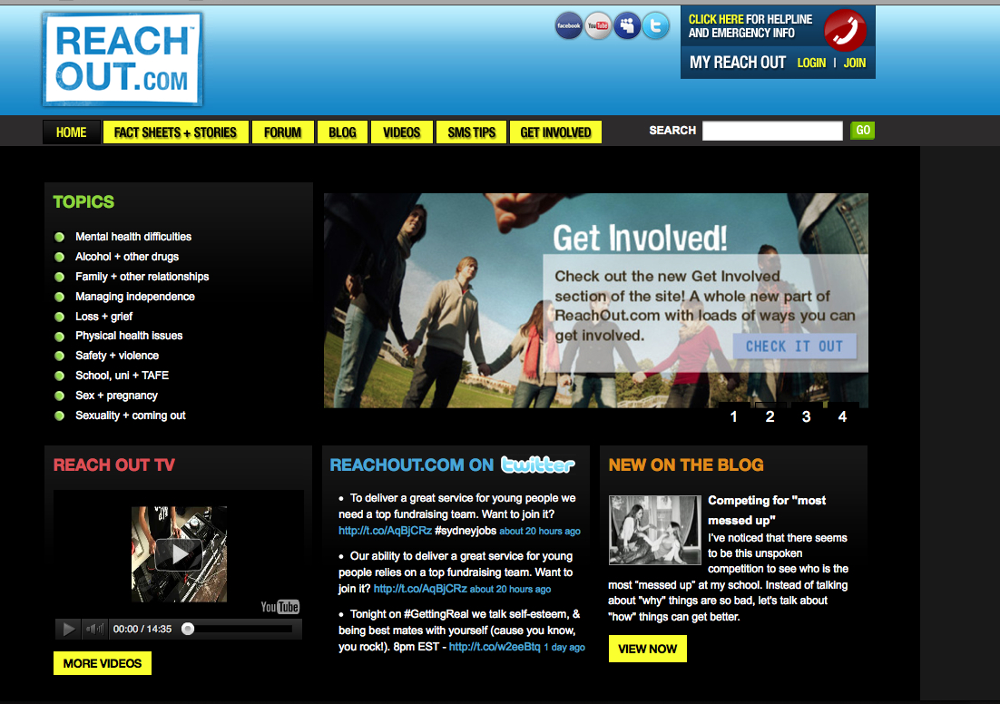
ReachOut
Notes:
ReachOut is a multi-level, multi-component mental health strategy. It connects young people to information, appropriate resources and sources of help. It provides a combination of
evidence-based mental health content with youth involvement programs and social branding to create a web-based service for young people experiencing adversity and mental health
difficulties.
Youth participation underpins all that we do – across all stages of formative design and planning, delivery and evaluation
Underpinned by extensive formative research: literature reviews; UX design and testing.

Slide 10
ReachOut.com’s
Evaluation Framework
Process and outputs

Slide 11
Purpose + aims of the evaluation framework
Ensure alignment between what we seek to achieve (objectives) and what we measure
Articulate the scope, focus and purpose of different program evaluation activities
Set priorities around what, when and how to evaluate the reach, impact and outcomes of the ReachOut program
Improve the rigour, quality and relevancy of evaluation outputs and findings
Notes:
Define the relationship between ‘research’ , ‘evaluation’ and ongoing program planning and development activities
Historically -
Emphasis on process measures (reach and activity)
Ad-hoc; often determined by (multiple) funding requirements
Integrated as part of larger research projects
Outsourced key evaluation activities
Myriad of evaluation activities, generating a large volume of data

Slide 12
Development process
Logics developed
Stakeholder evaluation needs assessed
Research methods & indicators selected
Notes:
Part of a bigger program redevelopment and planning project (NxGen) – governed by those timeframes. Challenges of lack of established guidelines and frameworks PLUS working in a multidisciplinary crew (idea of logics and frameworks was very foreign and took some significant cultural shifts) – but beyond scope of this discussion
Logic development: three logics (universal, selected, indicated) plus an overarching program logic.
Started with problem definition: in each logic, we explored (through desktop research, consultation with clinical experts and program planners): what’s amenable to change, what’s our expertise and strengths; environmental scan and development of objectives hierarchies.
Stakeholder needs assessment
Interviewed program team, research and policy team,
Included a review of key indicators and methodologies
Will expand on the aims and objectives when presenting the evaluation framework.
Program logic development - LFA
Problem definition and scoping
Objective hierarchy development
Long ‘ideal’ list of indicators and data collection methods
Evaluation needs assessment
Interviews and workshops with key stakeholders
to determine evaluation requirements
Contractual audit
Prioritisation
Evaluation framework developed

Slide 13
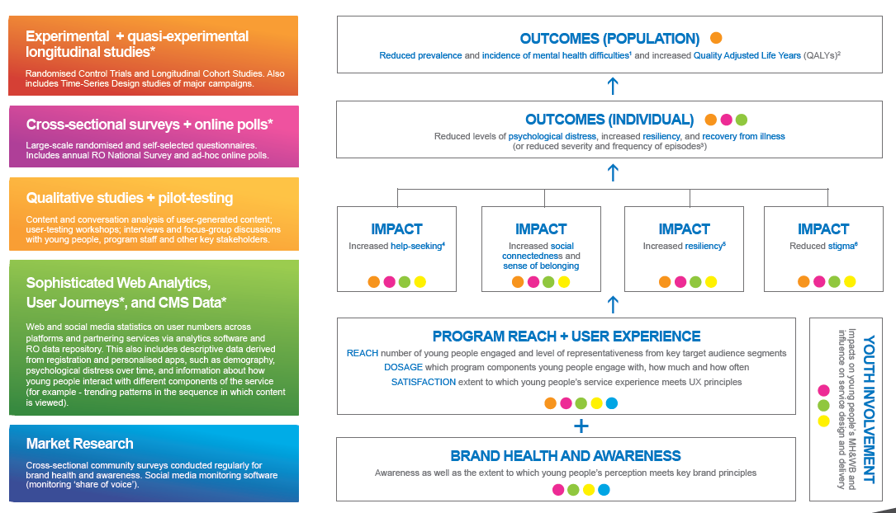
Evaluation framework
Notes:
Although it looks nice and simple, the process of getting here, and the detail within (and yet to be finalised) was not so simple! MORE ASPIRATIONAL than reflective…
Not going to go into too much detail about each of our evaluation projects, as that is not really the purpose of this presentation. Just to give an idea that it is multifaceted.
We use a mixed-method approach. Ultimately, we are reliant on data from a range of different sources in order to assess our program reach, impact and outcomes.
WORK IN PROGRESS – YET TO DESIGN AND IMPLEMENT ALL! Also fluctuates – needs to be flexible; varies according to budget and programmatic activity – which is very dynamic. Thus, it is more a decision making tool than anything else.
The web analytics and cross-sectional survey are particularly key. These are the two projects we’ve so far implemented. Asterisks represent projects being developed for future roll out. Yet to do so due to maturity of program and evaluation activities. As we generate further insights, we are able to better focus the scope of what to measure in more sophisticated projects.
Explain the web analytics and cross-sectional tools in more depth.
Cornerstone of the ReachOut.com evaluation framework – aims to measure program reach and impact alongside:
Web and social media analytics
Qualitative methods (content analysis, focus groups and interviews with participants)
RCTs of key program components (ROC game)
CMS also tells us about participation on site (comments, forum posts etc). Social media analytics tells us similar data about use in other channels

Slide 14
Web Analytics (Google)
Commercial web analytics software
Works using a JavaScript ‘tracking code’, embedded in every page of the ReachOut.com website
Collects and transmits visitor data to the Google server
Focus measures include
Proportion of Australian visitors
Unique visitors, returning visits and page views
Average time spent onsite*
Traffic sources (search engines, referring sites)
Page views
Notes:
Most widely used (free) commercial analytics product.
Google Analytics is implemented by including what is known as a "page tag". This is referred to as the Google Analytics Tracking Code (GATC) and is a snippet of JavaScript code that the user adds onto every page of his or her website. This code collects visitor data and sends it to a Google data collection server as part of a request for a web beacon.
To function, the GATC loads a larger Javascript file from the Google webserver and then sets variables with the user's account number. The larger file (currently known as ga.js) is typically 18 KB in size and is only downloaded once at the start of the visit as it will be cached throughout the session. As all websites that implement GA with the ga.js code are using the same master file from Google, a visitor that has previously visited any other website with this code implemented, will also have the file cached on their machine. The result is that the page overhead of including the GATC on web pages is kept to a minimum.
In addition to transmitting information to a Google server, the GATC sets first party cookies on each visitor's computer. This is used to store anonymous information such as whether the visitor has been to the site before (new or returning visitor), what is the timestamp of the current visit and what was the referrer site or campaign the visitor came from e.g. search engine, keywords, banner or email.
Allows comparisons on quality of engagement by source…

Slide 15
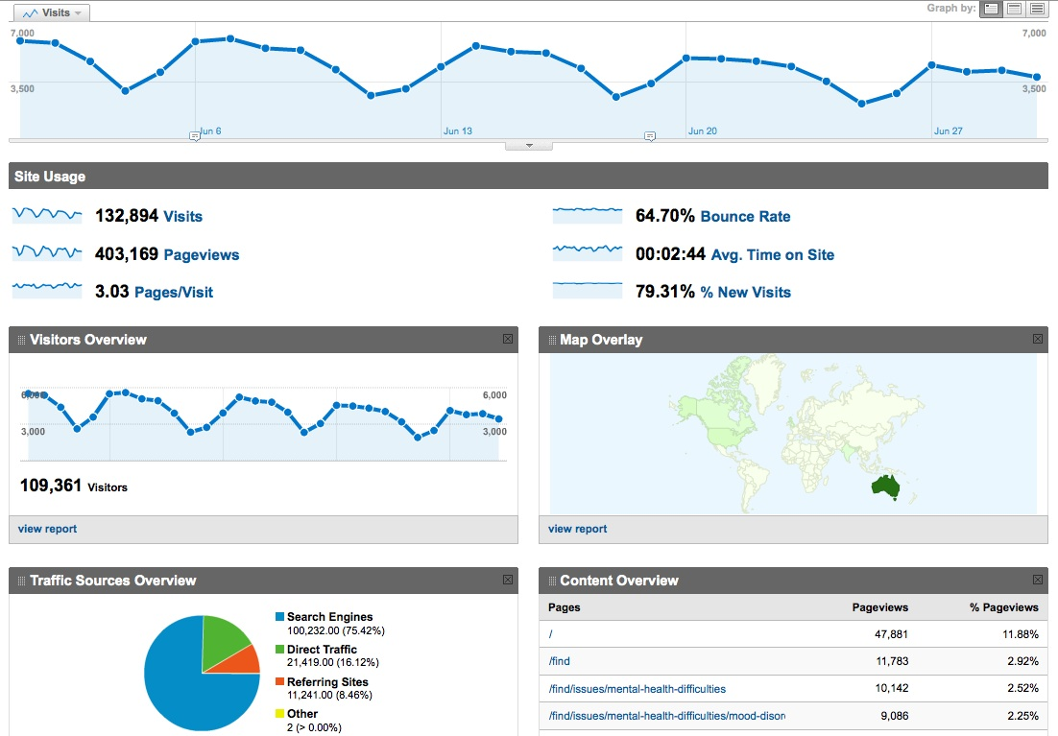
Google Dashboard
Notes:
Although it looks nice and simple, the process of getting here, and the detail within (and yet to be finalised) was not so simple!
Not going to go into too much detail about each of our evaluation projects, as that is not really the purpose of this presentation. Just to give an idea that it is multifaceted.
We use a mixed-method approach. Ultimately, we are reliant on data from a range of different sources in order to assess our program reach, impact and outcomes.
WORK IN PROGRESS – YET TO DESIGN AND IMPLEMENT ALL! Also fluctuates – needs to be flexible; varies according to budget and programmatic activity – which is very dynamic. Thus, it is more a decision making tool than anything else.
The web analytics and cross-sectional survey are particularly key. These are the two projects we’ve so far implemented. Asterisks represent projects being developed for future roll out. Yet to do so due to maturity of program and evaluation activities. As we generate further insights, we are able to better focus the scope of what to measure in more sophisticated projects.
Explain the web analytics and cross-sectional tools in more depth.
Cornerstone of the ReachOut.com evaluation framework – aims to measure program reach and impact alongside:
Web and social media analytics
Qualitative methods (content analysis, focus groups and interviews with participants)
RCTs of key program components (ROC game)
CMS also tells us about participation on site (comments, forum posts etc). Social media analytics tells us similar data about use in other channels

Slide 16
Annual cross-sectional survey
2010 Main measures focused on
Psychological distress (K-10), participant demographics, website usage and ratings, reasons for use, and perceived program impact on mental health literacy and help-seeking
Sample
Participation was voluntary, self-selected and anonymous
Of the 2,291 respondents who consented and began the survey, 67.8% (1,552) were aged in the target range of 14-25years
Ethics approval was obtained from the HREC at the University of Sydney
* currently being revised for 2012
Notes:
8th survey conducted since 2001 – builds extensively on previous versions and other Australian population health surveys
Constant measures over years provides comparison points.
Being revised in 2012!
Sampling (selection) bias; retention issues – like many other studies have reported – website surveys are notorious for attrition – we saw some substantial drop off throughout the survey.

Slide 17
2010 Results– process measures
Google Analytics data – website reach
1,158,100 unique visits in 12months ~ 96,000 unique visitors per month (UVM)
Visitor trends relatively constant; some spikes observed in relation to major campaigns and promotional activity and seasonal issues (e.g. exam periods)
Slight increase in average time spent onsite
Most commonly viewed pages:
  Depression: management and treatment
  Depression: types and symptoms
  Wanting to end your life
  If your friend threatens to take their own life
  What to do in an emergency
Notes:
Not going to go through all findings –

Slide 18
2010 Results – process measures
Cross-sectional survey – participant profile
70% are within are target group age range (14-25)
Geographic, cultural demography reflects target group
76% female, 23% male and 1% identify as transgender
70% are moderately to severely distressed (K-10 >22)
Majority cite the main reason for visiting as ‘I’m going through a tough time and looking for help’
Notes:
Not going through all findings:
Reasonably high reach but room to grow, given that there were X young people living in Australia!
Heavy skew to females; and while that is true of psych distress, it’s not quite THAT skewed! Controlled for in analysis of all variables. Not significant difference.
Educational and employment demographics also reflective.
Most seek information about mental health issues

Slide 19
2010 Results – process measures
Cross-sectional survey - program uptake and ‘dosage’
52% are return visitors (25% visited 20+ times)*
35% were members and 22% RAW e-news subscribers
Over 60% report spending > 10 mins on site per visit*
Significant proportion did not use and/or were not aware of the online forum or blog
Cross-sectional survey - participant satisfaction and experience
70% rate ReachOut.com as ‘very good’ or ‘excellent’
Fact sheets, personal stories rated ‘quite or ‘very’ useful (80% and 75% respectively)
A small percentage (9%) rated the navigation as ‘not at all good’ or ‘not very good’
Notes:
Contrast differences between GA and UP:
UP is confined to YP analysis?
Technical limitations of GA vs self-report bias of UP (see limitations later)
High loyalty
CMS also tells us more, but beyond scope of this preso.
Positive ratings suggest the program is well received by the target audience, though has some room for improvement in terms of navigation.

Slide 20
2010 Results – impact measures
ReachOut.com helped ‘quite a bit’ or ‘a lot’ to
Notes:
Encouraging. Compare help-seeking to those that don’t – 8% more…but ambiguously worded.
Short-term in focus. Missing measures for several key objectives (revised in 2012).
Relies on self-report – subject to social desirability and recall bias.
Increase my understanding about mental health issues (57%)
Help others going through a tough time (46%)
Learn skills, knowledge and confidence to seek help
Ask a professional for help (35%)
* Indicates new vs repat sig diff: P = <0.05 for last three – understand about mental health issues; other people’s experiences and helping others through a tough time*

Slide 21
Limitations & challenges
And future opportunities

Slide 22
Limitations
Cross-sectional survey:
Possible selection bias
Respondent drop-off
Validity and reliability unknown for some sections
Numerous measurement ‘blind-spots’ (not all objectives covered)
Can’t measure magnitude of impact or attribute impact to specific intervention components or ‘dosage’
Notes:
On reliability and validity – similar findings each year suggests it isn’t all bad!
On limited attribution: also limits insights into mechanics of the program and makes it difficult to determine what should or could be replicated
Drop-off and blind spots can be explains by length of survey and need to update with new logic.
CONSIDER STRUCTURING SLIDE WITH ADDING ‘SOLUTIONS’ NEXT TO EACH:
Random sampling procedure via survey software
Shorten survey and review usability with testing (consider multiple surveys)
Further testing with respondents; update with validated scales for impact indicators etc (addresses next point too)
Update with logics
Consider alternative designs – factorial analysis; time-series pre/post cohort etc…requires collecting more specific data about use of different areas

Slide 23
Limitations
Google Analytics:
Imprecise (doesn’t give absolutes)
Unable to measure exact number of people who visit (some may be counted twice; others as ‘bounces’)
Time on site is likely to be underestimated due to bounces
No set standard of metrics or benchmarks
Cannot correlate website utilisation with other information (such as process or impact measures)
Notes:
On limited attribution: also limits insights into mechanics of the program and makes it difficult to determine what should or could be replicated
Google Use relatives rather than absolutes and always focus on context
Limitations – mobiles, multi-tab browsing; shared IPs and single-page views
Additionally to the JavaScript-based client-side version, the Google Analytics can also work with websites browsed from mobile phones by using the Google Analytics for Mobile package which contains server-side tracking code for mobile sites using PHP, JSP, ASP.NET, or Perl as their server-side language.
However, many ad filtering programs and extensions (such as Firefox's Adblock and NoScript) can block the GATC. This prevents some traffic and users from being tracked, and leads to holes in the collected data. Also, privacy networks like Tor will mask the user's actual location and present inaccurate geographical data. Some users do not have JavaScript-enabled/capable browsers or turn this feature off. However, these limitations are considered small – affecting only a small percentage of visits.^{[6]}
The largest potential impact on data accuracy comes from users deleting or blocking Google Analytics cookies.^{[7]} Without cookies being set, GA cannot collect data. Any individual web user can block or delete cookies resulting in the data loss of those visits for GA users. Website owners can encourage users not to disable cookies, for example by making visitors more comfortable using the site through posting a privacy policy.
These limitations affect all on-site web analytics tools that collect on-site visitor data using page tags. That is, the small piece of code (usually JavaScript) that acts as a beacon to collect visitor data.
Another limitation of GA for large websites is the use of sampling in the generation of many of its reports. To reduce the load on their servers and to provide users with a relatively quick response for their query, GA limits reports to 500,000 randomly sampled visits at the profile level for its calculations. While margins of error are indicated for the visits metric, margins of error are not provided for any other metrics in the GA reports. For small segments of data, the margin of error can be very large.^{[8]}

Slide 24
Summary of key challenges
Absence of standards and frameworks for measuring and reporting of website usage metrics at both the individual and aggregate level
Absence of ethical guidelines for ensuring participant privacy and security
Striking the balance between flexibility, consistency and rigour
Technical constraints of web analytics tools leads to data inaccuracies
Sampling and retention issues limit the validity and reliability of survey data
Difficulty of multiple data sources: can’t correlate utilisation data with participant demography, impact and outcome measures – thereby limits insights into what (and how much of each) component(s) drive effectiveness

Slide 25
Concluding thoughts
Future directions and opportunities

Slide 26
Future directions for ReachOut.com
Redevelopment of Annual Cross-Sectional Survey
  Update of key indicators and measures to address blind spots
  Explore new sampling procedures (randomised selection)
  Improved survey experience through updated platform (e.g. using pre-existing data from CMS to pre-fill answers)
More sophisticated study designs and statistical techniques
  Cohort study and use of regression techniques to characterise reach (including dose-response effects) and changes in mental health outcome measures
  Social network analysis within the online community
Technological and methodological innovation
  CMS / information architecture development (including integration of social networking data) to provide objective and nuanced observations of on-site behaviours including: navigation pathways, components used, frequency and duration of use
Notes:
The study uses a prospective cohort design involving an intervention group (new users of ReachOut.com) and a matched control group (young people who do not use ReachOut.com). Outcome measures will include depressive symptoms and help-seeking behaviour, collected via online surveys at baseline and then at three, six and nine months. Repeated measures analysis of variance will test and measure the effect of
the intervention on the incidence of depressive symptoms and help-seeking behaviour. Similar analyses will test intervention effects on other protective factors. Regression analyses will ascertain the effectiveness of different program components amongst different intervention group sub-samples.
Correlate utilisation and participant profiling data with impact and outcome measures
OTHER SELECTION TECHNIQUES – USING PRE-FILLS AND ONLY ASKING PARTICIPANTS QUESTIONS

Slide 27
Summary of key recommendations
Multi-method evaluation designs (e.g. integration of web analytics and behavioural survey data), provide deeper insight & address some limits / constraints of each method
Develop consensus about reporting web site usage metrics
Avoid making comparisons across internet interventions that are heterogenous in design and outcome
Often ‘relatives’ provide more meaning than ‘absolutes’ in terms of web site usage metrics; but context is always key
Need to develop more sophisticated study designs and statistical techniques to better characterise the reach and effectiveness of online programs
Tailored user experience requires tailored program evaluation
Notes:
On sophistication – must be commensurate with the maturity of the program and available budget (like in all evaluations!)

